Slide 1
SMART IRRIGATION USING IOT
BY….
1. P.SRINIVASA BARGHAV
2. P.VEDA UPASAN
3.T.J VIJAY KRISHNA

Slide 2
INTRODUCTION: Internet of Things (IoT) technology has brought revolution to each and every field of common man’s life by making everything smart and intelligent. IoT refers to a network of things which make a self-configuring network. The development of Intelligent Smart Farming IoT based devices is day by day turning the face of agriculture production by not only enhancing it but also making it cost-effective and reducing wastage. The aim / objective of this paper is to propose a Novel Smart IoT based Agriculture Stick assisting farmers in getting Live Data (Temperature, Soil Moisture) for efficient environment monitoring which will enable them to do smart farming and increase their overall yield and quality of products. The Agriculture stick being proposed via this paper is integrated with Arduino Technology, Breadboard mixed with various sensors and live data feed can be obtained online from Thingsspeak.com. The product being proposed is tested on Live Agriculture Fields giving high accuracy over 98% in data feeds.

Slide 3
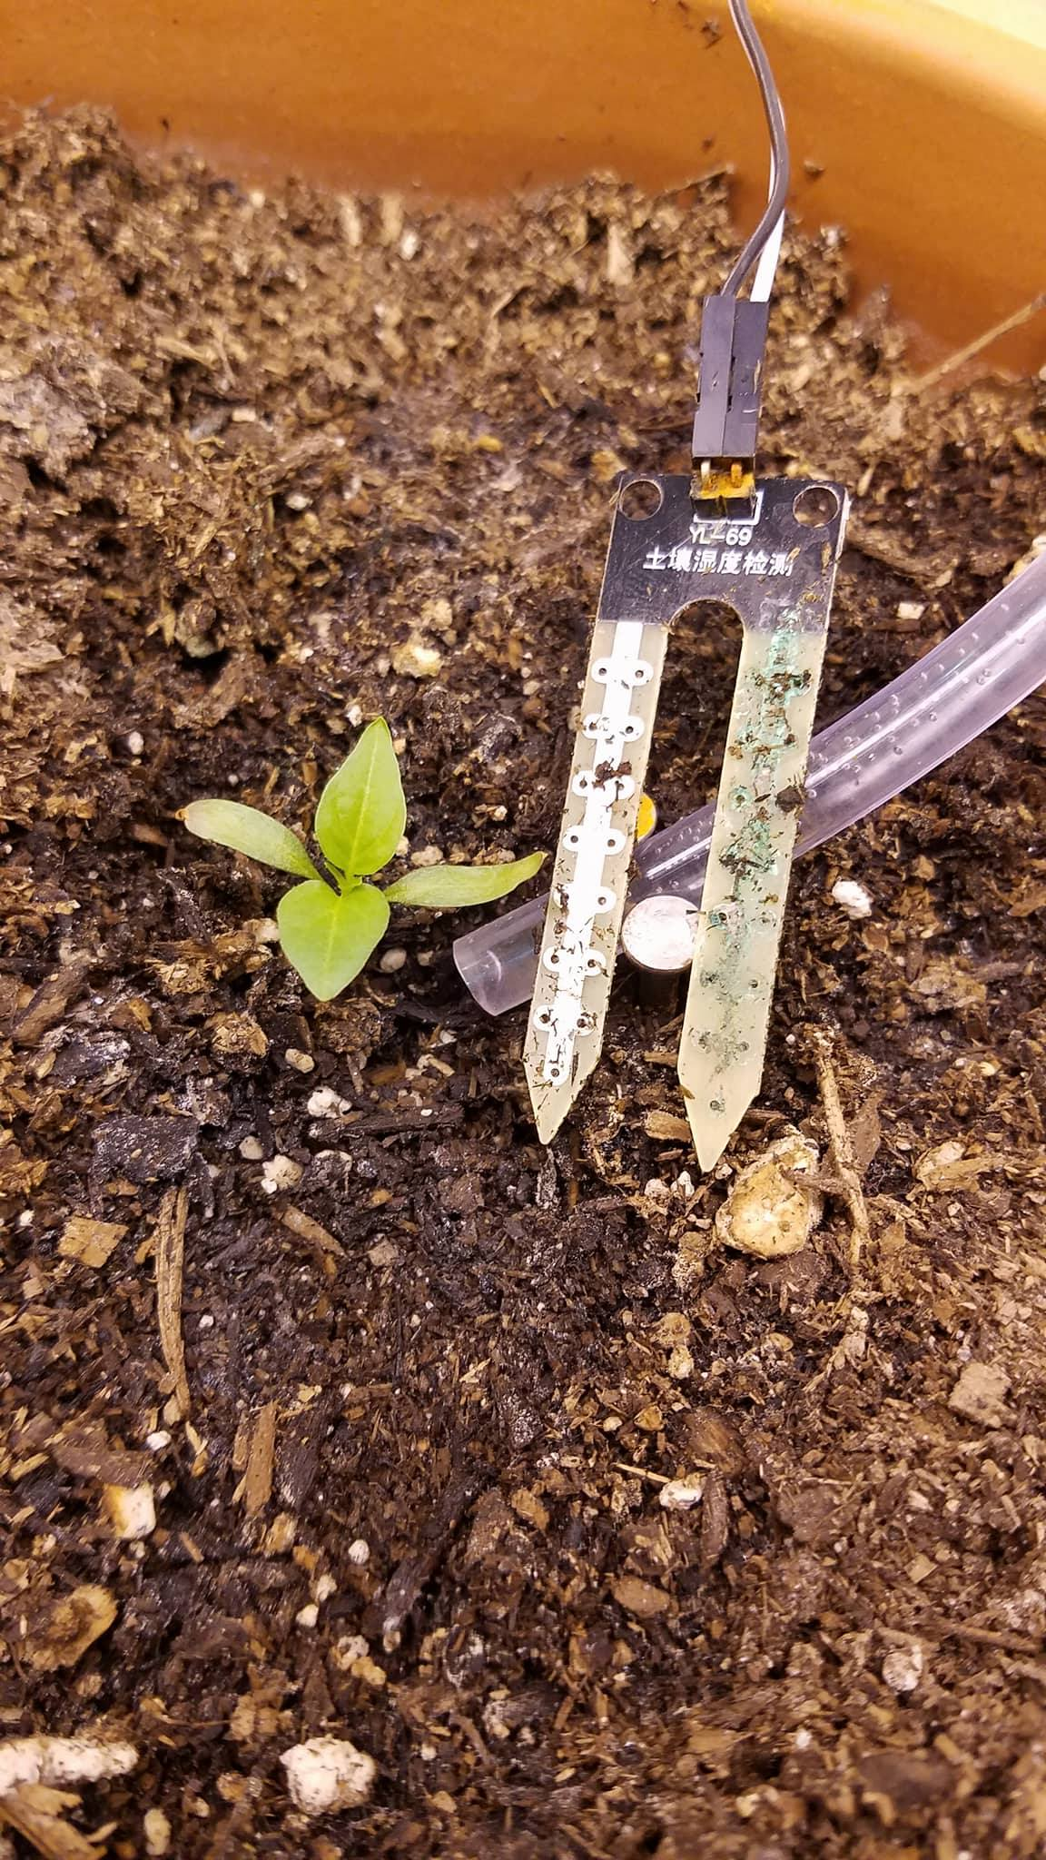
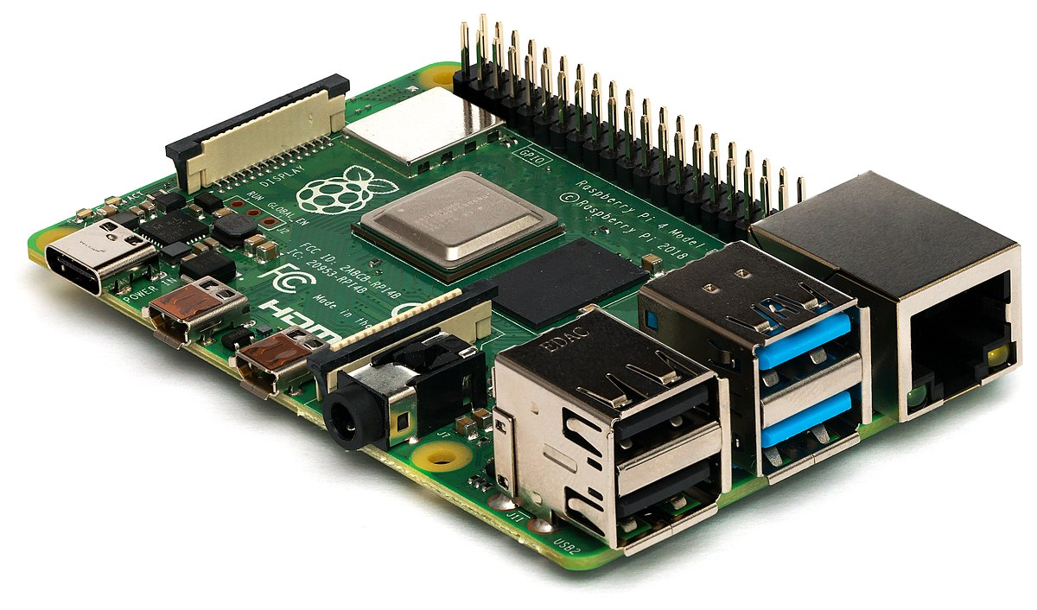
PRE-REQUISITS:
1.Raspberry pi
2. Soil Moisture sensor

Slide 4
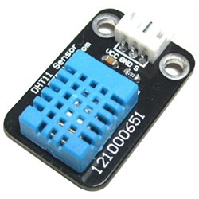
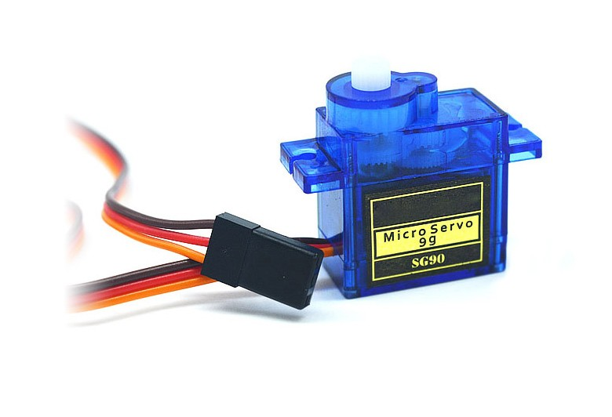

3. DHT11 sensor
4.Servo motor
5.IBM cloud

Slide 5
WORKING:
WORK FLOW OF THE SYSTEM:
Step 1: Start.
Step 2: The system can be initialised on Raspberry Pi.
Step 3: The soil moisture sensor checks the soil moisture level constantly.
Step 4: The sensor constantly senses the temperature and humidity of the field and updates the date in the web server.
Step 5: If the permissible level of water is less , then the relay which is connected to the Raspberry Pi will turn ON the motor.
Step 6: Similarly, if the soil becomes dry, the motor which is connected to the relay will be turned ON to wet the field.
Step 7: If the step 6 is completed, it will go to the step 3.
Step 10: Similarly, if the step 5 is over, the command will go to the step 3.

Slide 6
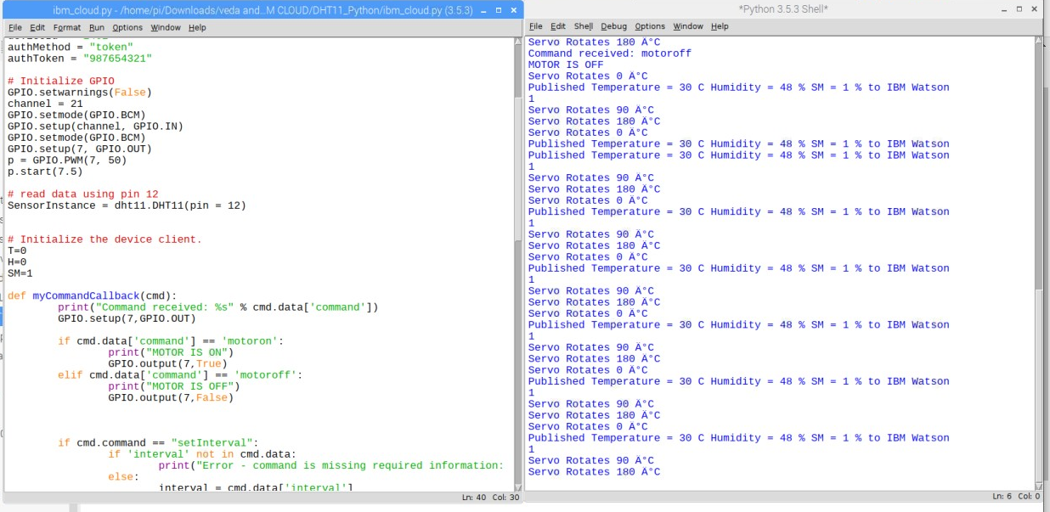
PROGRAM & OUTPUT

Slide 7
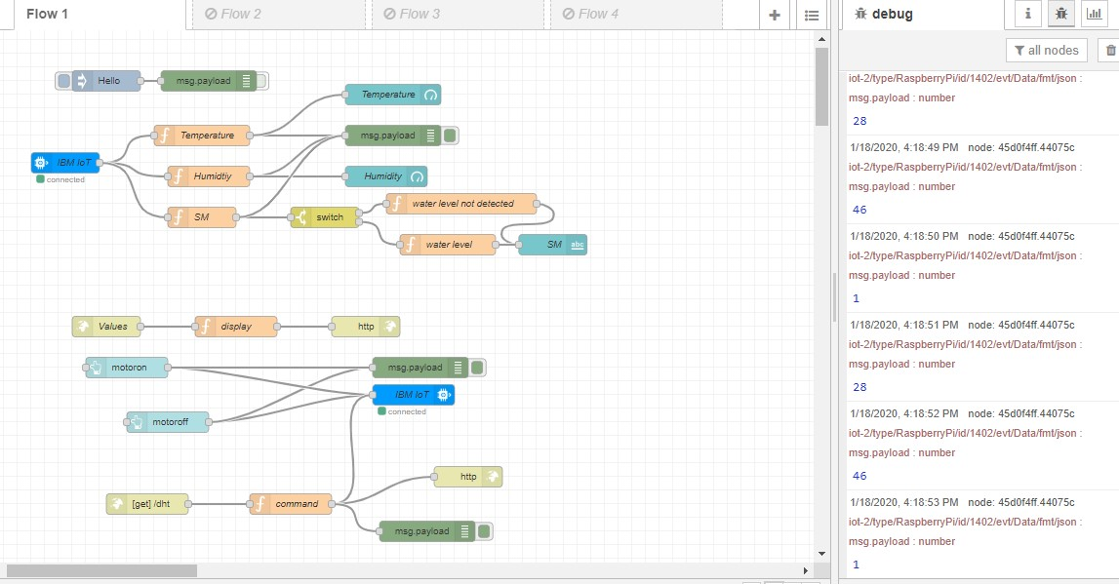
Node Red nodes

Slide 8
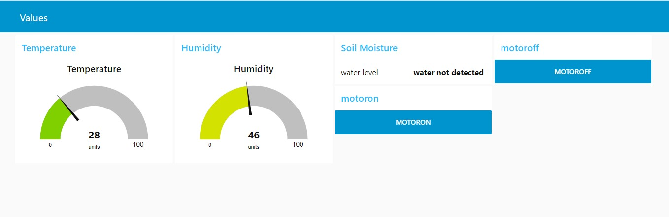
DASHBOARD

Slide 9
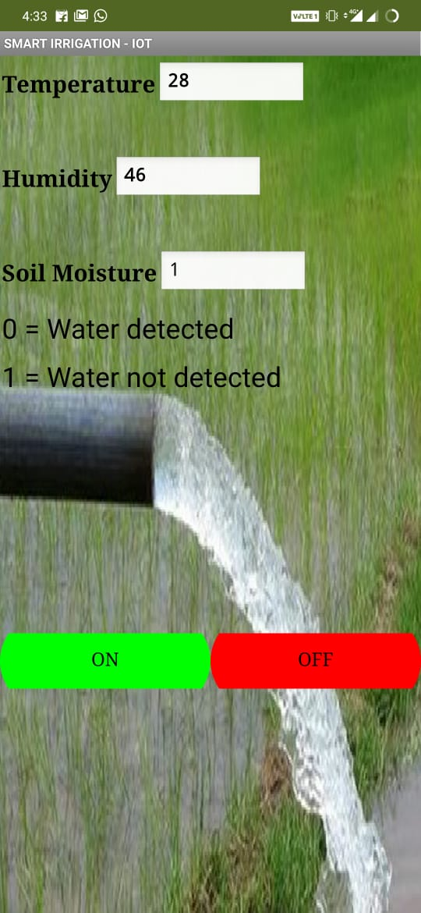
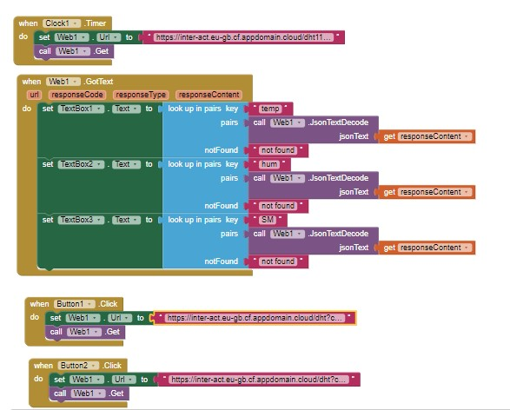
BLOCKS OF APPLICATION & MOBILE VIEW

Slide 10
CONCLUSION:
CONCLUSION: The smart irrigation system is suitable and cost effective for advance water resources for agricultural production. The system would provide feedback control system which will monitor and control all the activities of plant growth and irrigation system efficiently. If rain gun sensor can be added so that when it rains there won’t be floods. Rain water harvesting can be done and this harvested water can be used to irrigate fields. We can also include many more water quality sensors that affect the crops.

